Slide 1

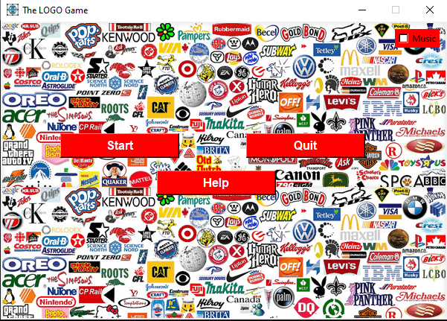
LOGO Quiz Game
Presenter Arsalan Khatri and Obaid Shaikh

Slide 2
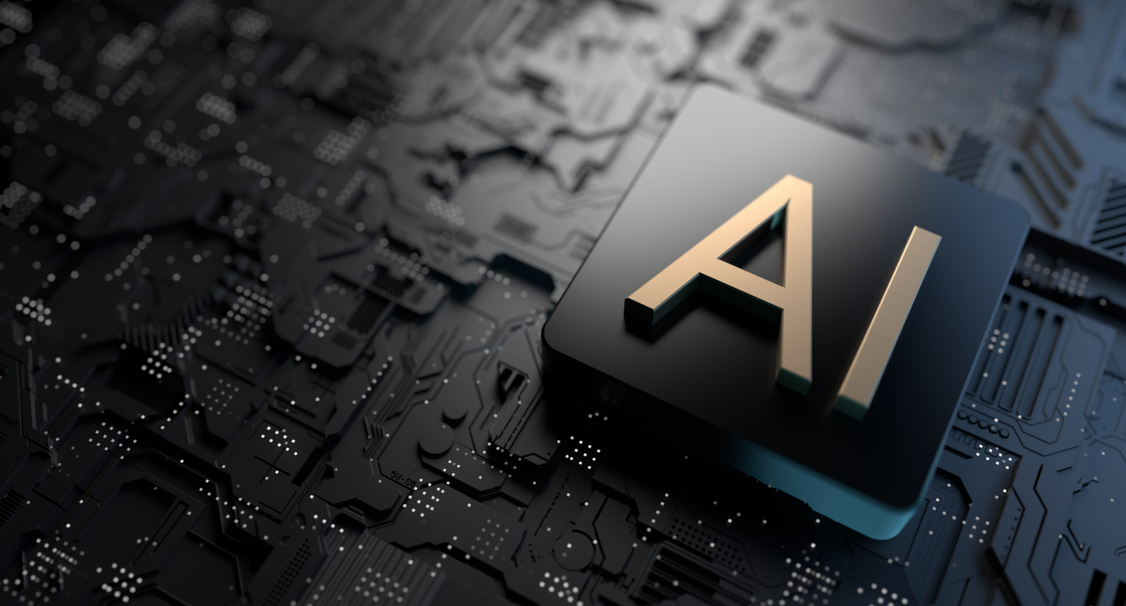
Group members:
Arsalan Khatri (BAI-21F-003)
Obaid Shaikh (BAI-21F-006)
Instructor
Mis Asma Sindhoo
Subject
Artificial Intelligence

Slide 3
Agenda
What is logo Quiz Game?
Introduction
Game Rules
How its work?
How we create Logo Quiz Game

Slide 4
What Is Logo Quiz Game?

Slide 5
Introduction
A logo quiz game is a type of game in which players are presented with an image of a logo and are challenged to identify the company or organization that the logo represents. These games are designed to test players' knowledge of logos and brand recognition. They can be entertaining as well as educational and can be played by people of all ages. Logo quiz games can be found in a variety of formats, including mobile apps and online games, and can be played on a wide range of devices, including smartphones, tablets, and computers. The gameplay typically involves looking at an image of a logo and trying to guess the name of the company or organization that the logo represents. Players can be given a limited amount of time or a set number of guesses to correctly identify the logos. As players correctly identify more logos, they earn points and advance to higher levels.

Slide 6
Game Rules
This is a guess the logo game with limited logos to identify.
Each logo displayed will have four options. Out of them only one will be correct.
If you select the right option your score will be incremented, and next logo will be displayed.
If you select the wrong option, you will lose. You have only one life.

Slide 7
How it’s work?
The game presents players with an image of a logo and a question or prompt asking them to identify the company or organization that the logo represents.
Players must use their knowledge of logos and brand recognition to make their guesses.
The game will indicate whether the player's guess is correct or not.
If the guess is correct, the player earns points or advances to the next level.
If the guess is incorrect, the player loses a guess and then play again.
As players correctly identify more logos, they may gain access to new logos.

Slide 8
Why we create this Game?
Logo quiz games are often created as a form of entertainment and to test players' knowledge of logos and brand recognition. They can be enjoyed by people of all ages and can be a fun way to learn about different companies and organizations.
Another reason is to promote brand awareness and recognition. By including logos of different companies, brands, and organizations in the game, it will help those entities to reach a wider audience, giving the players exposure to logos they may not be familiar with. it makes the players more likely to remember those logos and recognize them in the future.
Additionally, logo quiz games can also be used as an educational tool to help teach people about different industries and businesses. They can also be used in marketing campaigns and as a form of brand promotion.

Slide 9
How AI works in This Game
Image recognition: This involves training an algorithm to recognize and identify logos based on their visual features, such as shape, color, and patterns.
Natural Language Processing (NLP): This can be used to process and understand the user's inputs, such as guesses and requests for hints, in order to provide appropriate responses.
Machine Learning (ML): This technique can be used to train an algorithm to learn from the user's input and performance and make predictions about future gameplay.
Computer Vision: is used to process and analyze visual information, such as recognizing and identifying logos and images
Deep Learning : is a subset of Machine Learning which mainly used to train large and complex models with the help of Neural networks architectures.

Slide 10
LOGO QUIZ GAME MAKING

Slide 11

Modules Used
PyGame
Pillow(ImageTk)
Tkinter
Winsound
Random
Time

Slide 12
Pygame
Pygame is a library in Python that allows developers to create video games. It is built on top of the SDL library, providing low-level access to audio, keyboard, mouse, and display functions. It has built-in support for displaying graphics, handling user input, playing sounds and music, creating animations and game loops. Pygame provides a simple and easy-to-use API for creating games in python with high level functionality for creating 2D games.

Slide 13
Pillow
Pillow is a python library that deals with opening and manipulating various image formats. ImageTk is a submodule of the library, which can handle Tkinter PhotoImage objects. This module can be used to display images in a Tkinter-based interface.

Slide 14
Tkinter
Tkinter is a built-in Python library for creating graphical user interfaces (GUIs) using the Tk GUI toolkit. It provides a set of tools for creating widgets, such as buttons, labels, and text boxes, and for managing the layout and appearance of those widgets.

Slide 15
Random
The random library in Python is a built-in library that offers various functions for generating pseudo-random numbers and performing random operations such as selecting random elements, shuffling data and etc. It provides a way to generate random numbers and sample data in a non-deterministic way, the results are not truly random, but the library has several methods to handle the different use cases.

Slide 16
How we create This Game?

Slide 17
Creating a logo quiz game typically involves several steps, including the following
Gather logos and information
Design the game interface
Program the game mechanics
Test the game
Monitor and update the game
It's worth noting that creating a logo quiz game can be quite complex, depending on the specific requirements and features of the game, and would often require a team of game developers, designers, and testers.

Slide 18
1)Gather logos and information
The first step in creating a logo quiz game is to gather a collection of logos and information about the companies or organizations that the logos represent. This information may include the company's name, industry, location, and other relevant details.
2)Design the game interface
Once you have a collection of logos and information, the next step is to design the game interface. This typically involves creating a layout that will display the logos and any accompanying information, such as hints or prompts

Slide 19
3)Program the game mechanics
This will typically involve creating the logic and functions that will control how the game works, such as how logos are presented, how players make guesses, and how points are awarded.
4)Test the game
Before the game is released, it's important to test it thoroughly, to ensure it is working as intended, fix any bugs and make sure that the game runs smoothly on different devices.

Slide 20
Game Final Result

Slide 21
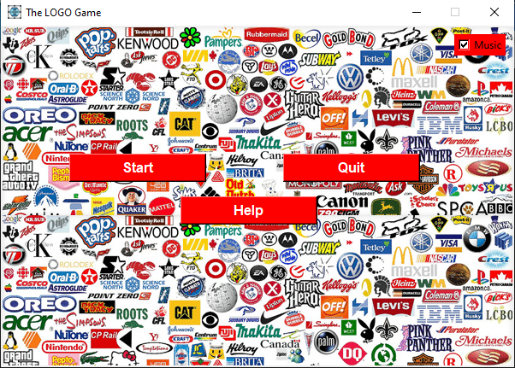
This is First interface Of Quiz Logo Game
This interface contain four options
Music (ON/OFF)
Start (Start Game)
Quit (End Game)
Help (Some instruction about Game)

Slide 22
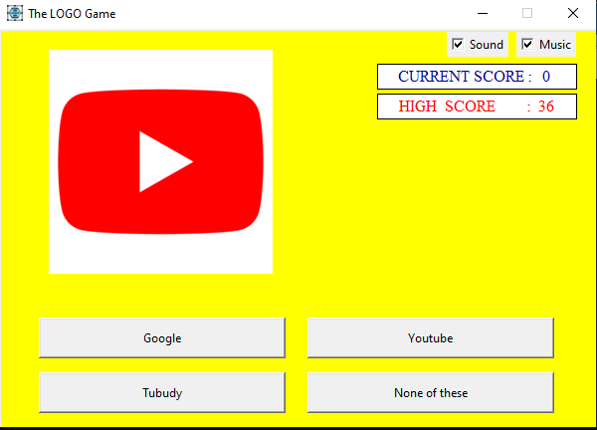
Logo Quiz Game Interface
This is Play Board Screen they contain
Current Score
High Score
Display Image
Four buttons

Slide 23
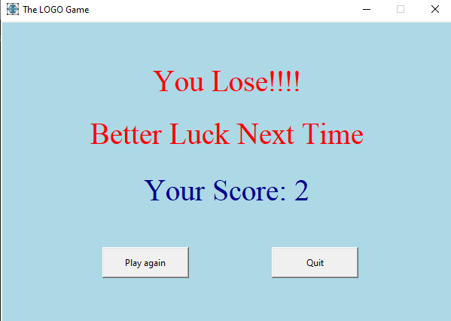
If we click right guess button, then we proceed next if we click wrong button then game will over, And Display this screen print your current Score in this screen.

Slide 24
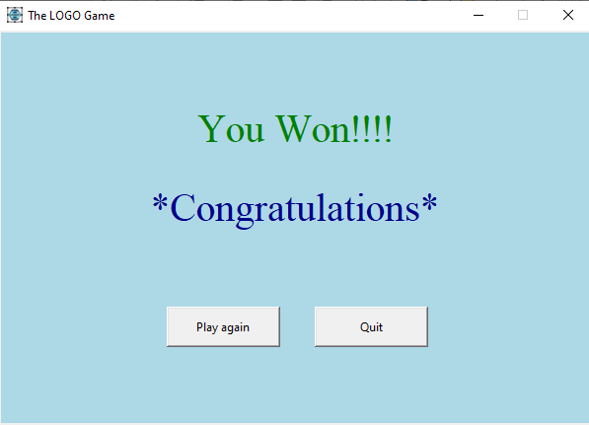
If you won, the Game this screen will show you if you play again this game click Play again button and if you Quit the game then click Quit Button

Slide 25
Thank You

